Slide 1



Identification of Redundant Code Using AI
Jaypee University of Information Technology, Waknaghat - 173234 (India)
Major Project - II (18B19CI891) | AY 2024-25
Mid-Term Evaluation | March 17-22, 2025.
Group No.: 86
Team Member (s)
Piyush Joshi (211397)
Samriti Thakur (211150)
Prakhar Varshney (211327)
Supervisor (s)
Dr. Ramesh Narwal
Assistant Professor
CSE&IT
Ms. Seema Rani
Assistant Professor
CSE&IT

Slide 2
Outline
Introduction
Problem Statement
Objectives
Work Done (after Major Project - I)
Project Design
Implementation
Experimental Results and Evaluation
Key Learnings
Work Plan (till End-Term Evaluation)
Work Contribution and Attendance
Supervisor Interactions
References

Slide 3
Introduction
Code redundancy, or duplicated code (code clones), is a common issue in software development. It occurs when developers replicate code segments to save time or due to a lack of collaboration. While this may seem convenient initially, redundant code increases codebase size, complicates maintenance and can introduce inconsistencies or bugs when updating code.
The "Identification of Redundant Code Using AI" project aims to address this challenge by employing machine learning (ML) and natural language processing (NLP) techniques. Using advanced ML models, the project will automatically identify both exact and semantic code clones. By training on a dataset of labeled redundant code patterns, the system will be able to detect clones across large codebases, highlighting areas for refactoring and improving code quality.
This AI-based approach will streamline code maintenance, reduce duplication, and contribute to more efficient software development practices by producing cleaner more maintainable code.

Slide 4
Problem Statement
Code redundancy, or "code clones," occurs when identical or near-identical code segments are scattered across a codebase due to copy-pasting or unintentional duplication.
This leads to increased codebase size, makes maintenance more difficult, and introduces the risk of inconsistencies when changes are applied to only one instance of a clone.
Traditional methods, like manual reviews or text-based detection, often miss "near-miss" clones, where minor changes exist, or semantic clones, where the code behaves the same but looks different.
As codebases grow, manual identification and refactoring of redundant code becomes impractical, resulting in decreased efficiency and increased technical debt.
The need arises for an automated solution capable of detecting both exact and semantic code clones to help developers maintain cleaner, more efficient codebases.

Slide 5
Objectives
Automate Detection of Code Clones: Develop an AI-based system that can efficiently detect both exact and semantic code clones across large codebases, reducing the manual effort involved in identifying redundant code.
Improve Codebase Quality: Minimize code duplication and technical debt by identifying areas of the code that can be refactored, ensuring cleaner, more maintainable, and scalable software development.
Enhance Development Efficiency: Provide developers with actionable insights through automated clone detection reports, enabling quicker identification of redundant code and faster resolution during the development and maintenance processes.
Create a User-Friendly Tool for Code Clone Detection: To develop an intuitive and effective tool that integrates the AI model and allows users to easily scan their codebases for redundant code patterns.

Slide 6
Work Done (after Major Project - I)
Dataset Collection & Preprocessing
Identified a new dataset consisting of 50 folders, each containing 500 code files solving the same task using different approaches.
Converted raw text files into a structured JSON format for model training.
Balanced the dataset by generating equal positive and negative code pairs (total 50,000 pairs).
Redundancy Detection Data Preparation
Ensured diverse and representative code samples for better generalization.
Optimized dataset size (64.6 MB) for efficient training on Google Colab.

Slide 7
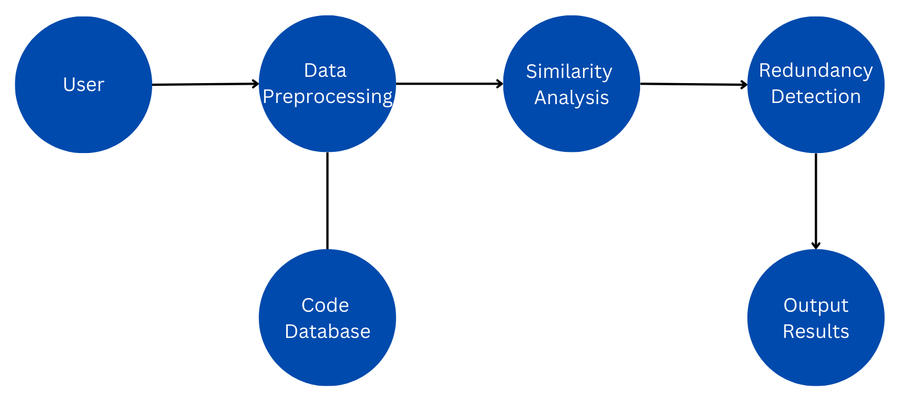
Project Design
Data Flow Diagram (DFD) for Redundant Code detection System.
Figure 1
Redundant Code detection Flow chart

Slide 8
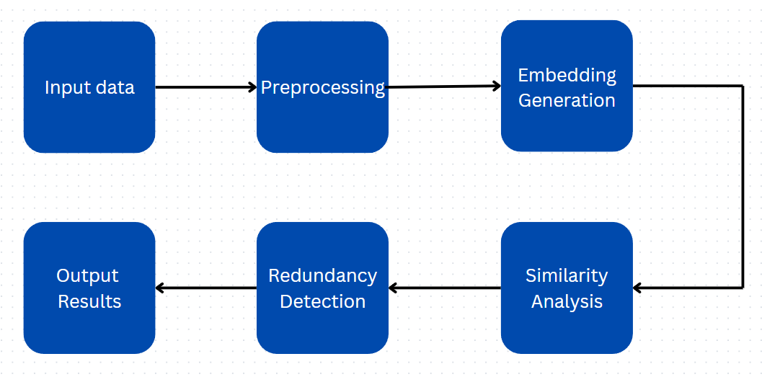
Project Design (cont…)
Project Design (cont…)
Data Flow Diagram (DFD) for Redundant detection model.
Figure 2
Redundant detection model data flow diagram

Slide 9
Project Design (cont…)
System Architecture
Input Layer: Raw code snippets from the dataset (JSON format). 1. Preprocessing Module:
Tokenization and normalization of code.
Feature extraction using TF-IDF and Cosine Similarity.
2. Model Development:
LSTM-based deep learning model for redundancy detection.
Training with balanced code pairs (positive & negative).
3. Prediction & Evaluation:
Model predicts redundancy score between code pairs.
Evaluation using Precision, Recall, and F1-score.

Slide 10
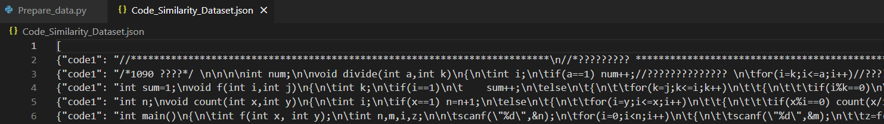
Implementation
Dataset & Preprocessing
Dataset Overview:
50 folders, each containing 500 programs solving the same task.
50,000 code pairs (25,000 positive & 25,000 negative pairs).
Dataset size: 64.6 MB (optimized for Google Colab).
Preprocessing Steps:
Extracted code from text files and converted them into JSON format.
Generated balanced code pairs using automated scripts.
Tokenized code snippets for model input.
Screenshot of the obtained dataset in json format

Slide 11
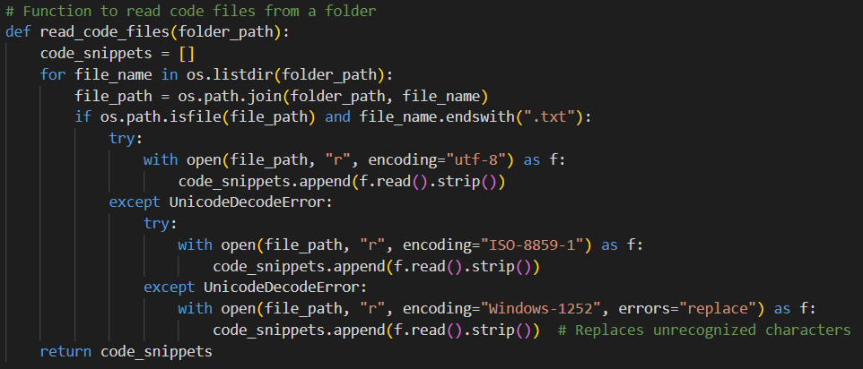
Implementation (cont…)
Core Implementation & Algorithms
Code Pair Generation Logic:
500 positive pairs per folder (same folder, different approaches).
500 negative pairs (cross-folder, different logic).
Key Code Snippet (Pair Generation Function):

Slide 12
Implementation (cont…)
Workflow & System Interaction
End-to-End Flow:
Step 1: Read dataset → Preprocess code → Generate balanced pairs.
Step 2: Convert pairs into tokenized sequences → Train LSTM model.
Step 3: Model predicts redundancy → Evaluate results → Optimize performance.
Key Modules & Interaction:
Data Loader: Reads and structures code pairs.
Preprocessing: Tokenization & embedding generation.
Model Training: LSTM-based learning of code similarities.
Evaluation: Precision, recall, F1-score analysis.

Slide 13
Experimental Results and Evaluation
Dataset Insights & Pairing Validation
Key Findings from Dataset Creation:
Pairing Strategy Validation:
Same-folder pairs (redundant) show high similarity in logic but differ in style.
Cross-folder pairs (non-redundant) have clear structural and functional differences.
Diversity Analysis:
Code snippets vary in syntax and structure, ensuring a realistic dataset.
Some identical logic implementations appear with different function names and variable choices.
Dataset Composition:
50,000 pairs → 25,000 redundant, 25,000 non-redundant
Ensured equal distribution to avoid model bias.

Slide 14
Experimental Results and Evaluation (cont…)
Comparison with Existing Approaches
Baseline Methods Explored:
Cosine Similarity + TF-IDF:
Simple text-based comparison of code.
Issue: Struggles with semantic similarity when variable/function names differ.
AST (Abstract Syntax Tree) Similarity:
Examines structural similarity of code.
Issue: Doesn't capture logic-level redundancy across different implementations.
Why Our Dataset Matters?
Pairs generated programmatically → Removes subjectivity in manual labeling.
Covers a wide range of problem-solving techniques → Useful for real-world redundancy detection.
Scalable & adaptable → Can support different programming languages in the future.

Slide 15
Key Learnings
Dataset Challenges & Preprocessing
Handling a large dataset (64.6MB).
Managing imbalanced data and ensuring equal positive & negative pairs.
Addressing encoding issues (e.g., UnicodeDecodeError) for smooth data loading.
Code Pair Generation
Creating structured training pairs from 50 folders, ensuring diverse redundancy patterns.
Balancing dataset effectively: 500 positive & 500 negative pairs per folder.
Feature Representation
Need for an effective tokenization approach for code comparison.
Understanding similarity metrics like TF-IDF & Cosine Similarity.

Slide 16
Work Plan (till End-Term Evaluation)
Phase 1: LSTM Model Development
Implement an LSTM-based deep learning model for code similarity detection.
Convert code pairs into tokenized sequences for model input.
Train the model using balanced positive and negative pairs.
Phase 2: Model Evaluation & Optimization
Evaluate model performance using accuracy, precision, recall, and F1-score.
Visualize results with confusion matrix, ROC curve, and precision-recall curve.
Optimize hyperparameters (learning rate, batch size, dropout) for better performance.
Phase 3: Result Analysis & Documentation
Analyze model performance and interpret results.
Document findings and potential improvements.

Slide 17
Work Contribution and Attendance
GitHub Repository URL: https://github.com/piiyushJoshi/Redundant-Code-Identification-Using-AI
Team Member | Roll No. | Work Done (provide complete details) | Work Contribution (%) | Lines of Code (LoC) | Lab Attendance (%)
1. | 211397 | Worked on writing python scripts for automating the process of converting dataset into json format and creating code pairs. | 37.5 |  | 100
2. | 211150 | Worked on developing the python scripts and analysed the dataset and ensured the balance within. | 37.5
3. | 211327 | Worked on finding and managing the initial textual dataset. Created the presentation. | 25

Slide 18
Supervisor Interactions (as mentioned in weekly log)
No. of Meetings with Supervisor: 6
Week No. | Duration | Remarks (as mentioned in the weekly log) | Incorporated (Yes/No)
1. | 20/01/2025 to 25/01/2025 | Remark 1 Remark 2 Remark 3 | Yes
2. | 27/01/2025 to 01/02/2025 | Remark 1 Remark 2 Remark 3 | Yes
3. | 03/02/2025 to 08/02/2025 | Remark 1 Remark 2 Remark 3 | Yes
4. | 17/02/2025 to 22/02/2025 | Remark 1 Remark 2 Remark 3 | Yes
5. | 24/02/2025 to 01/03/2025 | Remark 1 Remark 2 Remark 3 | Yes

Slide 19
Supervisor Interactions (cont…)
Week No. | Duration | Remarks (as mentioned in the weekly log) | Incorporated (Yes/No)
6. | 03/03/2025 to 08/08/2025 | Remark 1 Remark 2 Remark 3 | Yes
7. | dd/mm/2025 to dd/mm/2025 | Remark 1 Remark 2 Remark 3
8. | dd/mm/2025 to dd/mm/2025 | Remark 1 Remark 2 Remark 3

Slide 20
References
[1] Feng, Z., Guo, D., Tang, D., Duan, N., Feng, X., Gong, M., Shou, L., Qin, B., Liu, T., Jiang, D. and Zhou, M., 2020. Codebert: A pre-trained model for programming and natural languages. arXiv preprint arXiv:2002.08155.
[2] Svajlenko, J. and Roy, C.K., 2015, September. Evaluating clone detection tools with bigclonebench. In 2015 IEEE international conference on software maintenance and evolution (ICSME) (pp. 131-140). IEEE.
[3] Kim, D.K., 2019. Enhancing code clone detection using control flow graphs. International Journal of Electrical & Computer Engineering (2088-8708), 9(5).
[4] Swaraj, A. and Kumar, S., 2023. Programming Language Identification in Stack Overflow Post Snippets with Regex Based Tf-Idf Vectorization over ANN. In ENASE (pp. 648-655).
[5] Ragkhitwetsagul, C., Krinke, J. and Clark, D., 2018. A comparison of code similarity analysers. Empirical Software Engineering, 23, pp.2464-2519.
[6] Ain, Q.U., Butt, W.H., Anwar, M.W., Azam, F. and Maqbool, B., 2019. A systematic review on code clone detection. IEEE access, 7, pp.86121-86144.
[7] Van Rysselberghe, F. and Demeyer, S., 2003, September. Evaluating clone detection techniques. In Proc. Int’l Workshop on Evolution of Large-scale Industrial Software Applications (ELISA) (pp. 25-36).

Slide 21
References (cont…)
[8] R. Smith and S. Horwitz, “Detecting and measuring similarity in code clones,” *ResearchGate*, 2009.
[9] Martin White, Michele Tufano, Christopher Vendome, and Denys Poshyvanyk : “Deep Learning Code Fragments for Code Clone Detection”,2015.
[10] Neha Saini, Sukhdip Singh, Suman : Code Clones: Detection and Management . In International Conference on Computational Intelligence and Data Science (ICCIDS 2018) .
[11] Dong Kwan Kim :Enhancing code clone detection using control flow graphs. In International Journal of Electrical and Computer Engineering (IJECE) Vol. 9, No. 5, October 2019, pp. 3804~3812 ISSN: 2088-8708, DOI: 10.11591/ijece.v9i5.pp3804-3812 .
[12] Ajad Kumar, Rashmi Yadav and Kuldeep Kumar: A Systematic Review of Semantic Clone Detection Techniques in Software Systems. IOP Conf. Series: Materials Science and Engineering 1022 (2021) 012074.
[13] Morteza Zakeri-Nasrabadi, Saeed Parsa , Mohammad Ramezani, Chanchal Roy, Masoud Ekhtiarzadeh : A systematic literature review on source code similarity measurement and clone detection: Techniques , applications ,and challenges.The Journal of Systems & Software 204 (2023) 111796.

Slide 22
References (cont…)
[14] IEEE Transactions on Power Systems, vol. 32, no. 3, pp. 2142-2151, May 2017.
[15] K. A. Kontogiannis, R. De Mori, E. Merlo, M. Galler, and M. Bernstein, "Pattern Matching for Clone and Concept Detection," Automated Software Engineering, vol. 3, pp. 77–108, 1996
[16] Z. A. Alzamil, "Application of Redundant Computation in Program Debugging," Journal of Systems and Software, vol. 81, no. 11, pp. 2024–2033, Nov. 2008.
[17] M. Zhang, "Detecting Redundant Operations with LLVM," GSoC 2015 Proposal, unpublished, 2015.
[18] Marcus, A., & Maletic, J. I. (2001). Identification of High-Level Concept Clones in Source Code. Proceedings of the International Conference on Automated Software Engineering (ASE '01), pp. 46-53.
[19] Zhou, T., Tian, R., Ashraf, R. A., Gioiosa, R., Kestor, G., & Sarkar, V. (2022). ReACT: Redundancy-Aware Code Generation for Tensor Expressions. Proceedings of the International Conference on Parallel Architectures and Compilation Techniques (PACT '22).
[20] Xu, Z., & Sheng, V. S. (2024). Detecting AI-Generated Code Assignments Using Perplexity of Large Language Models. Proceedings of the AAAI Conference on Artificial Intelligence, 38(21), 23155-23162.

Slide 23
Thanks.

